Slide 1
Data Curation Project
Presentation by:-
Malhar Patwari (A20410420)

Slide 2
Dataset
Food Inspection Data – City of Chicago
Characteristics:
Data Size – 191 MB
Tuple Count – 168K
Number of Attributes – 17
Data Format – CSV File

Slide 3
Data Quality Issues
Null Values
Typo Error’s
Data Duplication
Invalid Characters

Slide 4
Tools
Python
Jupyter Notebook
Google API
Open Refine

Slide 5
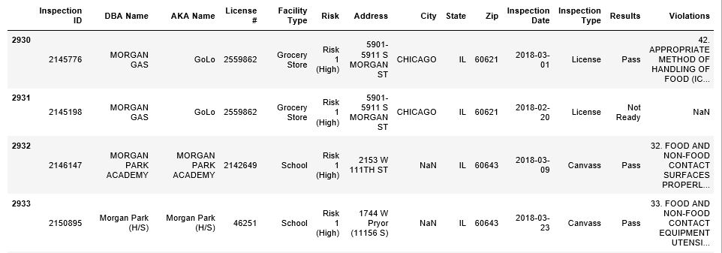
City Attribute
Problem:- NULL Values

Slide 6
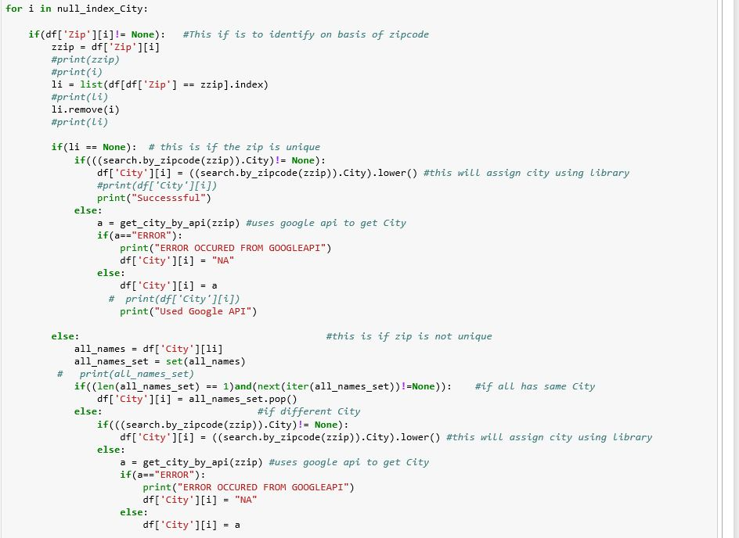
Code Snippet

Slide 7
City Attribute:- Solution
Solution:-
ZIP, Address, Lat-Long,
If present -> scans DB -> if same for all / above threshold(50%) -> use the value in the corresponding field
b. If found below threshold then use local library/Google API

Slide 8
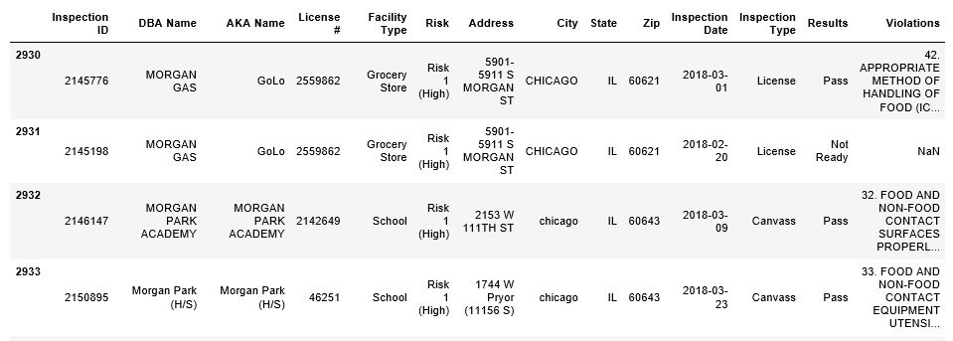
City Attribute: Results

Slide 9
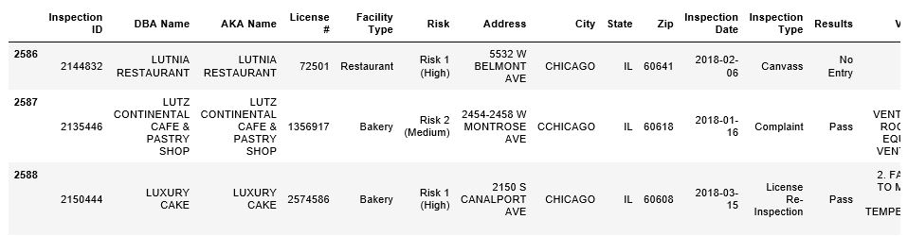
Typos
Used Edit Distance

Slide 10
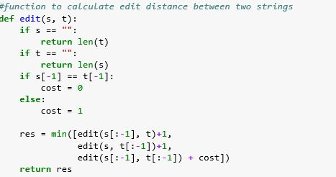
Typos Code Snippet

Slide 11
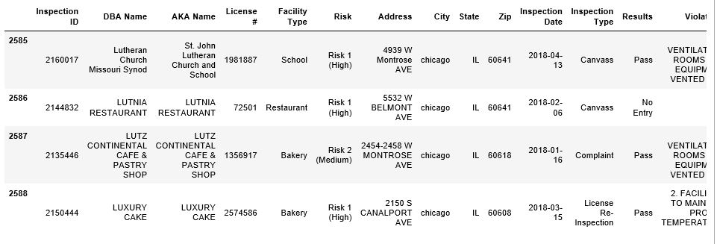
Typos: Result

Slide 12
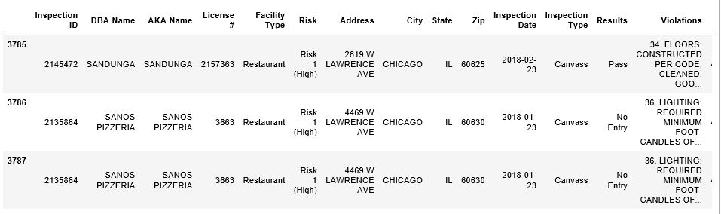
Data Duplication
Removed Data Redundancy

Slide 13
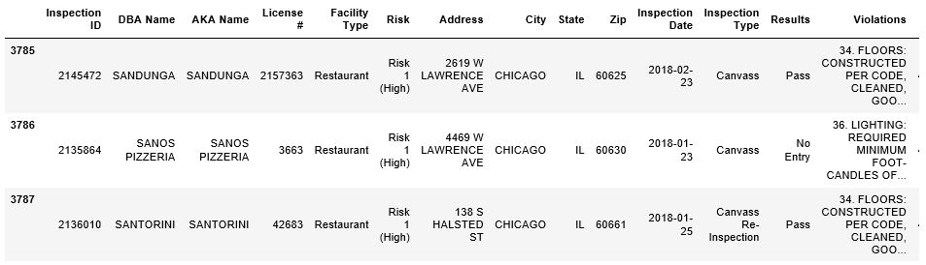
Data Duplication: Result

Slide 14
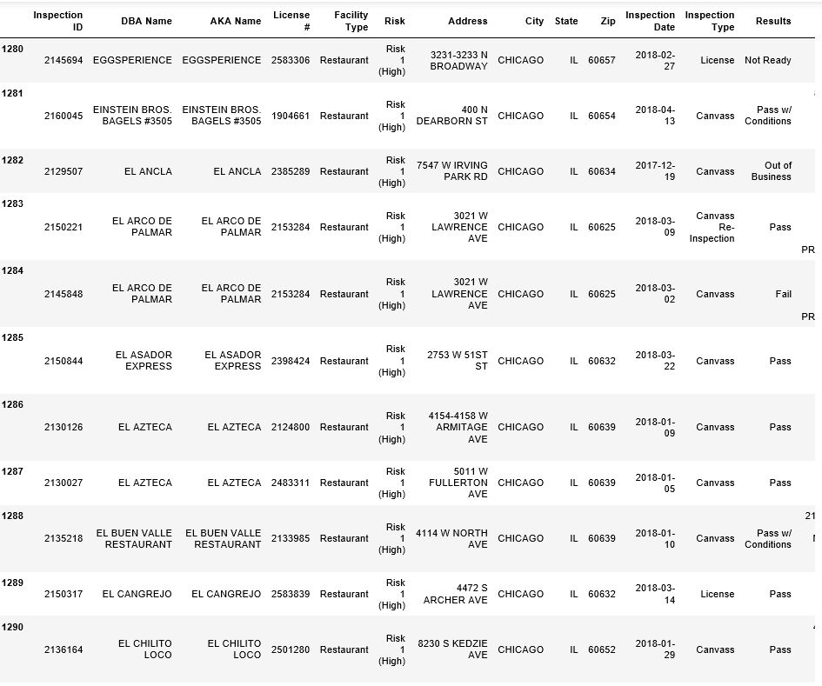
Final Result

